Slide 1
PROJECT TITLE:Responsive portfolio website
AUTHOR:K.SWETHA
COURSE:Bsc.Computer science
DATE:04.09.2025

Slide 2
PROBLEM STATEMENT
Many beginners struggle to present their skills, projects, and contact details in a simple, professional way.
Need for a personal portfolio website that is clean, interactive, and easy to build with basic web technologies.

Slide 3
PROJECT OVERVIEW
This project is a Portfolio Website built using HTML, CSS, and JavaScript.
It contains sections like About Me, Projects, and Contact Information.
Includes interactive features such as background color transition using JavaScript.

Slide 4
END USER
Students – showcase academic projects.
Job Seekers – highlight skills and contact details.
Freelancers – display portfolio and services.
Developers/Designers – maintain an online presence.

Slide 5
TOOLS AND TECHNIQUES
HTML5 → For structure of the portfolio.
CSS3 → For styling, layout, and transitions.
JavaScript → For interactivity (changing background colors).
Browser (Chrome/Edge/Firefox) → For testing and execution.
Text Editor (VS Code / Sublime / Notepad++) → For coding.

Slide 6
PORTFOLIO DESIGN AND LAYOUT
Header → Name, tagline, and background change button.
About Section → Short introduction.
Projects Section → List of sample projects with hover effects.
Contact Section → Email and phone details.
Responsive Layout → Clean design with smooth transitions.

Slide 7
FEATURES AND FUNCTIONALITIES
Dynamic Background Color – changes on button click using JavaScript.
2. Smooth Transitions – CSS animations for hover effects and background.
3. Interactive Cards – projects highlight when hovered.
4. Responsive Structure – fits both desktop and mobile screens.

Slide 8
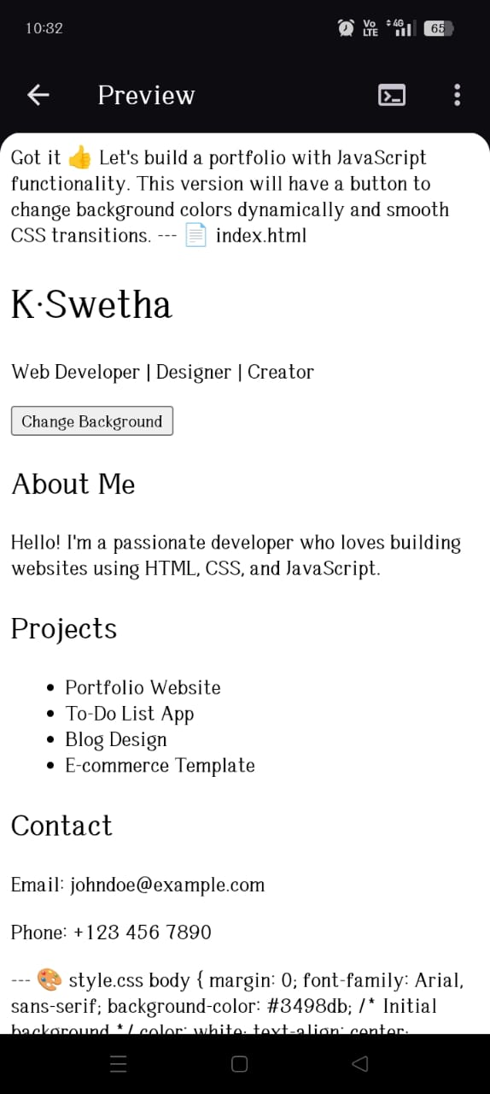
RESULT AND SCREENSHOTS

Slide 9
COnclusion
The project demonstrates how HTML, CSS, and JavaScript can be combined to create an interactive portfolio.
It is a beginner-friendly project yet effective for personal branding.
Can be extended further by adding features like dark mode, animations, and navigation menus.
Provides a strong foundation for web development skills.

